Slide 1
Data Analytics
National Academy of Indian Railways
Workshop on 'New Financial Initiatives' in Indian Railways
For
Principal/ Coordinating FA&CAOs
23 December 2015

Slide 2
There are
Lies
Damned lies; and?
Statistics

Slide 3
Data Analytics
What do you understand by it?

Slide 4
Plan for the session
An example
Data Analytics
Digital Dashboard
Use of Numbers
Reorganising Statistical Units
Data on Indian Railways
Analytics Ecosystem on IR
A word of caution

Slide 5
An example from Railways
Not Financial Data

Slide 6
Accidents on Indian Railways
An illustration

Slide 7
Cause wise Analysis of Consequential Train Accidents over IR
(2006-07 to 2014-15)
Cause | 2006-07 | 2007-08 | 2008-09 | 2009-10 | 2010-11 | 2011-12 | 2012-13 | 2013-14 | 2014-15
Failure of Railway staff | 84 | 87 | 83 | 63 | 56 | 52 | 46 | 51 | 62
Failure of other than Railway staff | 87 | 81 | 68 | 75 | 57 | 63 | 59 | 56 | 58
Failure of equipment | 7 | 9 | 0 | 6 | 5 | 5 | 6 | 4 | 2
Sabotage | 8 | 7 | 13 | 14 | 16 | 6 | 3 | 3 | 3
Combination of factors | 1 | 0 | 4 | 1 | 3 | 1 | 0 | 0 | 0
Incidental | 7 | 8 | 5 | 4 | 4 | 3 | 7 | 3 | 8
Could not establish | 1 | 2 | 4 | 2 | 0 | 1 | 0 | 0 | 0
None Held | 0 | 0 | 0 | 0 | 0 | 0 | 1 | 0 | 2
Awaited | 0 | 0 | 0 | 0 | 0 | 0 | 0 | 1 | 0
Total | 195 | 194 | 177 | 165 | 141 | 131 | 122 | 118 | 135

Slide 11
Consequential Accidents over the years

Slide 13
Consequential Accidents over the years

Slide 14
Consequential Accidents over the years

Slide 15
Seasonal variations?
A widely prevalent belief
Specific types of accidents have higher frequency in different times of the year

Slide 21
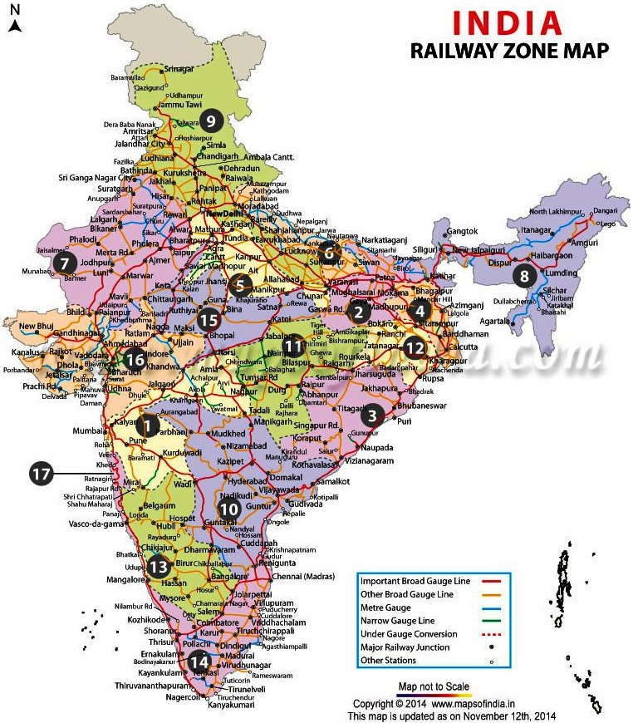
May-June

Slide 22
July-September

Slide 23
December - January

Slide 24
March – April
October - November

Slide 25
Month-wise distribution of Different types of Accidents in the period 2006-2015

Slide 26
Month-wise distribution of Different types of Accidents in the period 2006-2015

Slide 31
Causes of Accidents 2006-2015: Trends

Slide 32
Causes of Accidents 2006-2015: Trends

Slide 33
Derailments
Cause-wise Analysis
(2006-07 to 2014-15)

Slide 34
Manned LC Accidents
Cause wise Analysis
(2006-07 to 2014-15)

Slide 35
Unmanned LC Accidents
Cause wise Analysis
(2006-07 to 2014-15)

Slide 36
Preventive Measures To Curb UMLCs
As on 01.04.2015, there were approximately 29487 LC on IR out of which 19047 (64.6%) are Manned and 10440 (35.4%) are Unmanned.
Progress made in elimination of LC in last 5 years & up to July, 2015 by Closure, Merger, Subway and Manning are as under
UMLC | By Closure/ Merger/Subway | By Manning | Total
2010-11 | 800 | 434 | 1234
2011-12 | 481 | 777 | 1258
2012-13 | 700 | 463 | 1163
2013-14 | 777 | 325 | 1102
2014-15 | 721 | 427 | 1148
Total 2010-15 | 3479 | 2426 | 5905
2015-16 (Up to July’15) | 206 | 65 | 271
MLC | 2010-11 | 2011-12 | 2012-13 | 2013-14 | 2014-15 | Total 2010-15 | 2015-16 (Up to July’15)
By Closure | 133 | 225 | 257 | 301 | 310 | 1226 | 89

Slide 37
Data Analytics

Slide 38
What is data analytics?
Derive meaning from data by incorporating
Statistics
Mining of data
Visualisation
Extracting actionable data in a manner that supports decision-making

Slide 39
What is data analytics?
Massive expansion in the ability of computers to handle data leading to certain other crucial items now becoming possible:
Machine Learning
Database engineering
All this to solve complex problems

Slide 40
What is data analytics?
Caters to Big Data with a view to capturing major and seemingly minor relationships of performance indices
Caters to day to day reporting needs
Caters to ad hoc querying
Provides analytical dashboards and alerts
Provides comprehensive information and actionable insights for taking informed decisions

Slide 41
What has changed?
More powerful computers
Methods to obtain data directly from source
Data feeds available from diverse sources
Algorithms to extract information from unstructured data

Slide 42
4 Vs of Big Data
Volume
Scale of data
Variety
Different forms of data
Veracity
Uncertainty of data
Velocity
Analysis of data

Slide 43
Insights into the data
Traditional business intelligence
  What happened?
Diagnostic analytics
  Why is it happening?
Predictive
  What will happen in future?
Prescriptive
  What should we do?

Slide 44
Communication Flow in Analytics
Service request by User
Request assigned a priority number
Design team selects dashboard format
Feedback is sent to Analyst for recalibration/modification
Continuous monitoring and upgradation
Analyst, with assistance from User, creates functional requirements
Implementation team implements the selected model

Slide 45
Analytics Team
Functional User
Functional Analyst
providing liaison between User and Technology Team
Technology team
    Software Programmers
    to extract data from databases and prepare it for analytical models
    Data Scientists
    to decide choice of model and provide interpretation of analytical output in functional terms
    Statistical Analysts/Econometricians
    for developing appropriate logical and physical data models
    Quantico Analysis Team
    testing the quality of product from non-functional point of view

Slide 46
Present
Extract data
Analyze
Decide action
Action?
Delays in access to data
Limited electronic filing and diary
Limited integration with policy and financials
Multiple manual processes to enter, correct, extract and analyze data
Delayed decision making based on limited information and insights

Slide 47
Possibilities in future
Extract data
Analyze
Decide action
Action
Shorter duration for analysis
Shorter time-lapse for decision
Quality of data analysis provides decision support
Continuous feedback on decisions taken
Rapid course correction if needed
Easier launching of new initiatives

Slide 48
Features determining analytics maturity
Use of real time data
Electronic filing and diary in a centralised model for each business
Information integrated across the organization
Advanced modeling techniques used to evaluate across functional areas
Fully simulated business operations to evaluate decisions

Slide 49
Digital Dashboard
A crucial tool

Slide 50
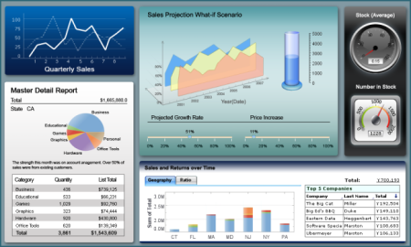

Slide 51
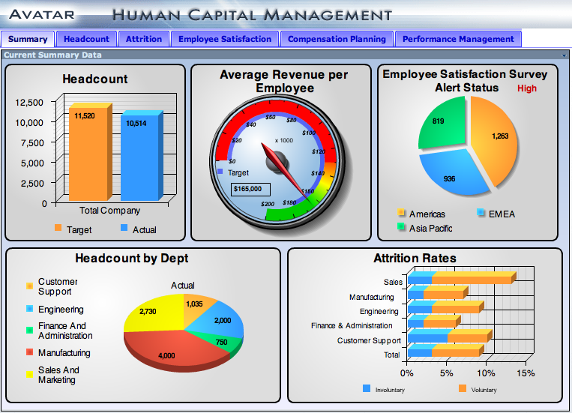

Slide 52
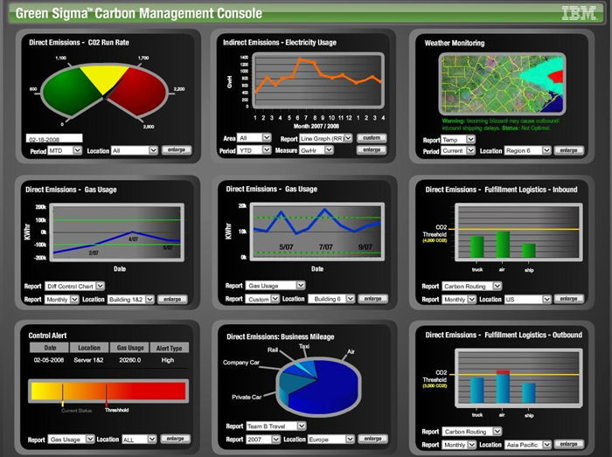

Slide 53
The Digital Dashboard
Visual depiction
Timely alerts
Multi device
Drilldown capability

Slide 54
The Digital Dashboard
Relevance
  Right insight at the right time
Convenience
  Readily available when needed
Validation
  Checked for errors and model validity

Slide 55
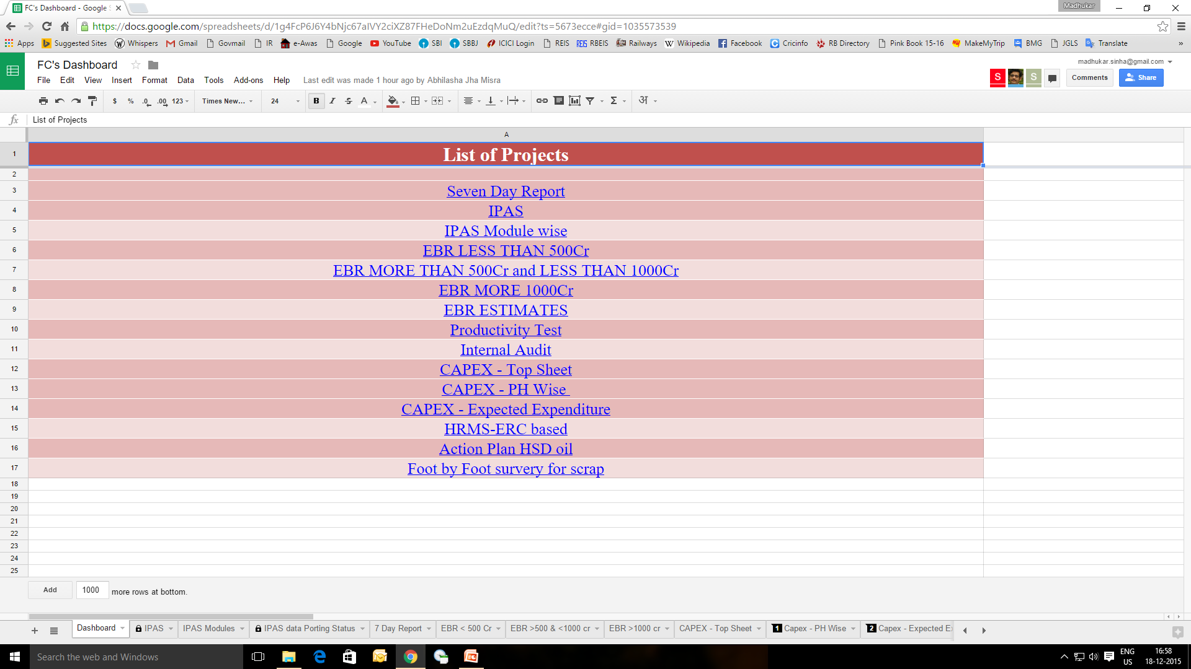

Slide 56
Use of numbers
Statistician’s delight

Slide 57
la loi des grands nombres
(Law of Large Numbers)
If the expected result of an experiment is random
And the experiment is repeated a large number of times
Then the results tend to stabilise over a period of time

Slide 58
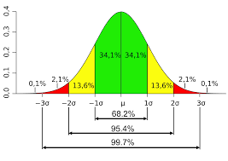

Slide 59
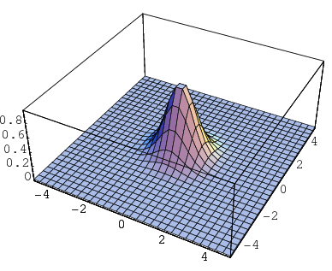

Slide 60

Statistician’s Delight

Slide 61
Dependent and Independent variables
y = a₀x₀+ a₁x₁+ a₂x₂+ a₃x₃+ ε

Slide 62
Dependent and Independent variables
Throughput = f (Availability of
power
reliable signalling,
Crew,
TXR cleared RS,
efficient controllers,
motivated staff and officers,
reliable equipment of all types,
etc.)

Slide 63
Optimisation
Max. [y – (ax+ by+ cz)]

Slide 64
Optimisation
Maximise Throughput
Subject to: loco failures, signal failures, crew non-availability, failing rolling stock, absence of crucial staff, demotivated staff and officers, other asset failures, etc.

Slide 65
Data on Indian Railways
Our position

Slide 66
Recording of data on IR
I Digitally Captured Digitally Reported | II Manually Captured Digitally Reported
IV Digitally Captured Manually Reported | III Manually Captured Manually Reported
Quadrant I is ideal.
However, on IR data can be available to varying degrees in all Quadrants.

Slide 67
Data on Indian Railways
Several IT projects on IR have potential for data analytics:
Data Warehouse for PRS
Data Warehouse for UTS
Data Warehouse for FOIS
Control Office application
Integrated Coach Monitoring System (ICMS)
Loco Sheds Management System (LSMS)
Software for Locomotive Asset Management (SLAM) for Electric Loco Sheds
Track Management System (TMS)
MIS for Land & Amenities on IR
Traction Distribution Management System (TDMS)
Signaling Maintenance Management System (SMMS)
Expenditure side application of PRIME/AFRES/IPAS/ e-Recon/ARPAN etc.

Slide 68
Data on Indian Railways
Tickets
reserved / unreserved
Freight
RRs
Train movement
control office
Crew
movement and lobbies
Maintenance
P Way and fixed assets
Maintenance
Rolling stock
Materials
purchase and depots
HR
manpower deployment and staff welfare
Costing and accounting – all of the above

Slide 69
Reorganising Statistical Units
Change

Slide 70
Reorganizing Statistical Unit to Analytics Unit
Dynamic officers with adequate field experience and IT knowledge should lead the team
Identify comparatively younger staff and train them in data handling and analysis
Involve young JE level staff of EDP centres as part of the Unit
Unit should provide analyzed inputs to all departments

Slide 71
Analytics Ecosystem on IR
Something new

Slide 72
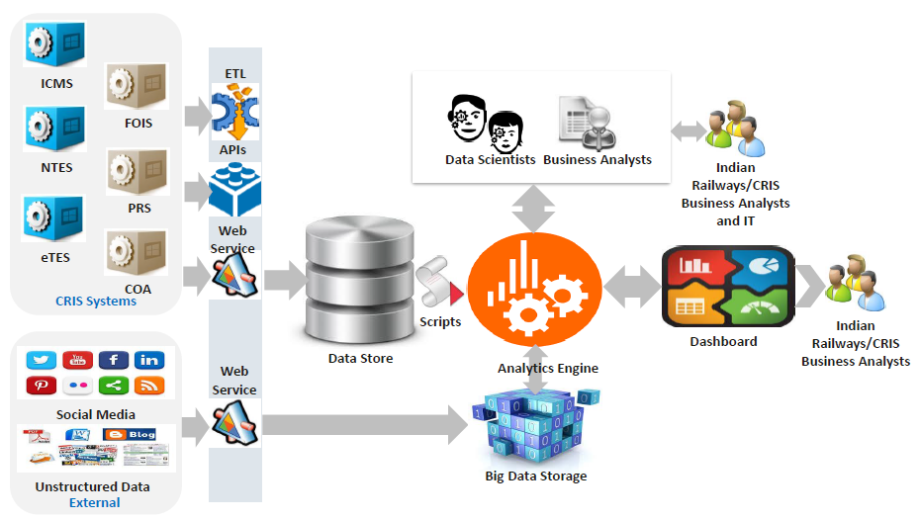
An Analytics Ecosystem for IR

Slide 73
Possible Areas for Analytics
Predictive maintenance
Dynamic pricing
Evaluating different marketing strategies
Improving capacity utilization/route congestion
Real time management of linear and rolling stock assets

Slide 74
Possible Areas for Analytics
Expenditure on Fuel consumption
Correlation with changes in fuel prices, Specific Fuel Consumption of locomotives, route electrification and transport output
RCD wise energy rate and consumption data
Automatic alerts in case the inventory of fuel increases to more than 10 days
Expenditure on Traction Bills
Correlation with prices of traction, Loco-wise and EMU coach wise energy consumption and transport output
TSS-wise energy rate and consumption data
Automatic alerts in cases of diesel locos running under wires

Slide 75
Don’t rely too much on predictive capacity of current data
Some theoretical stuff

Slide 76
An economist can affect the economy
as much as
The weatherman the weather

Slide 77
Logical fallacy
Post hoc ergo propter hoc?
The rooster crows before sunrise.
Ergo the rooster causes sunrise.
Cum hoc ergo propter hoc?
Rate of deaths in India due to TB increased even as civilian deaths during war in Iraq was increasing
Ergo War in Iraq was the cause of increase in TB death rate in India

Slide 78
Chaos Theory
Chaos
When the present determines the future,
but the approximate present does not approximately determine the future

Slide 79
Chaos Theory
Does the flap of a butterfly’s wings in Brazil set off a tornado in Texas?
The butterfly does not power or directly create the tornado
The flapping of wings by the butterfly is a set of initial conditions which are followed by the tornado – the final result
Had the butterfly not flapped its wings, the trajectory of the system might have been vastly different
For want of a nail the shoe was lost.
For want of a shoe the horse was lost.
For want of a horse the rider was lost.
For want of a rider the message was lost.
For want of a message the battle was lost.
For want of a battle the kingdom was lost.
And all for the want of a horseshoe nail.

Slide 80

Thank You

